Slide 1

HMS VARBoard
Team Zeta
Clint Smith | Jennifer Douglas
Rahul Gedupudi | Steve Iwanowski
Tony Lanzer | Troy Vars

Slide 2

Mo’ Customers Mo’ Problems for VARs
Did you upgrade your customers this year?
Are all of your Customization Packages published and working?
Are all of your customers properly licensed? Are they getting close to a limit?
Do your customers actually close their modules and periods so they don’t enter data into the wrong period?
Do you want the ability to be proactive and easily identify and circumvent potential problems?

Slide 3
SaaS Client Dashboard for VARS
Demo will show internal dashboard option for showing client health.
Acumatica versions and builds for each of the configured customers. Show retired versions in red color.
Customization counts for each customer. Deployed/Published
License Usage (Data from licensing console in a single place for all customers). Show customers exceeding license limits in red color.
Month/Year when the books were last closed (for each customer)
If external access is preferred, framework supports alternative options for data using oData or endpoints, and display such as PowerBI.

Slide 4
Design
An endpoint was created to expose relevant data securely. This end point will be deployed as a customization package for each of the customers on the VARs support plan.
In the VARs Acumatica instance, we will have:
Processing screen that calls each of the active customer’s endpoint to pull the data and store on the VAR DB instance either manually or by automated schedule.
Ability to see the data for each individual customer.
Grid that shows all the customer instances.
Ability to add new customers:
For each customer (Acumatica URL / endpoint, connection credentials, Active/Inactive)
Dashboard that displays data from custom tables.

Slide 5
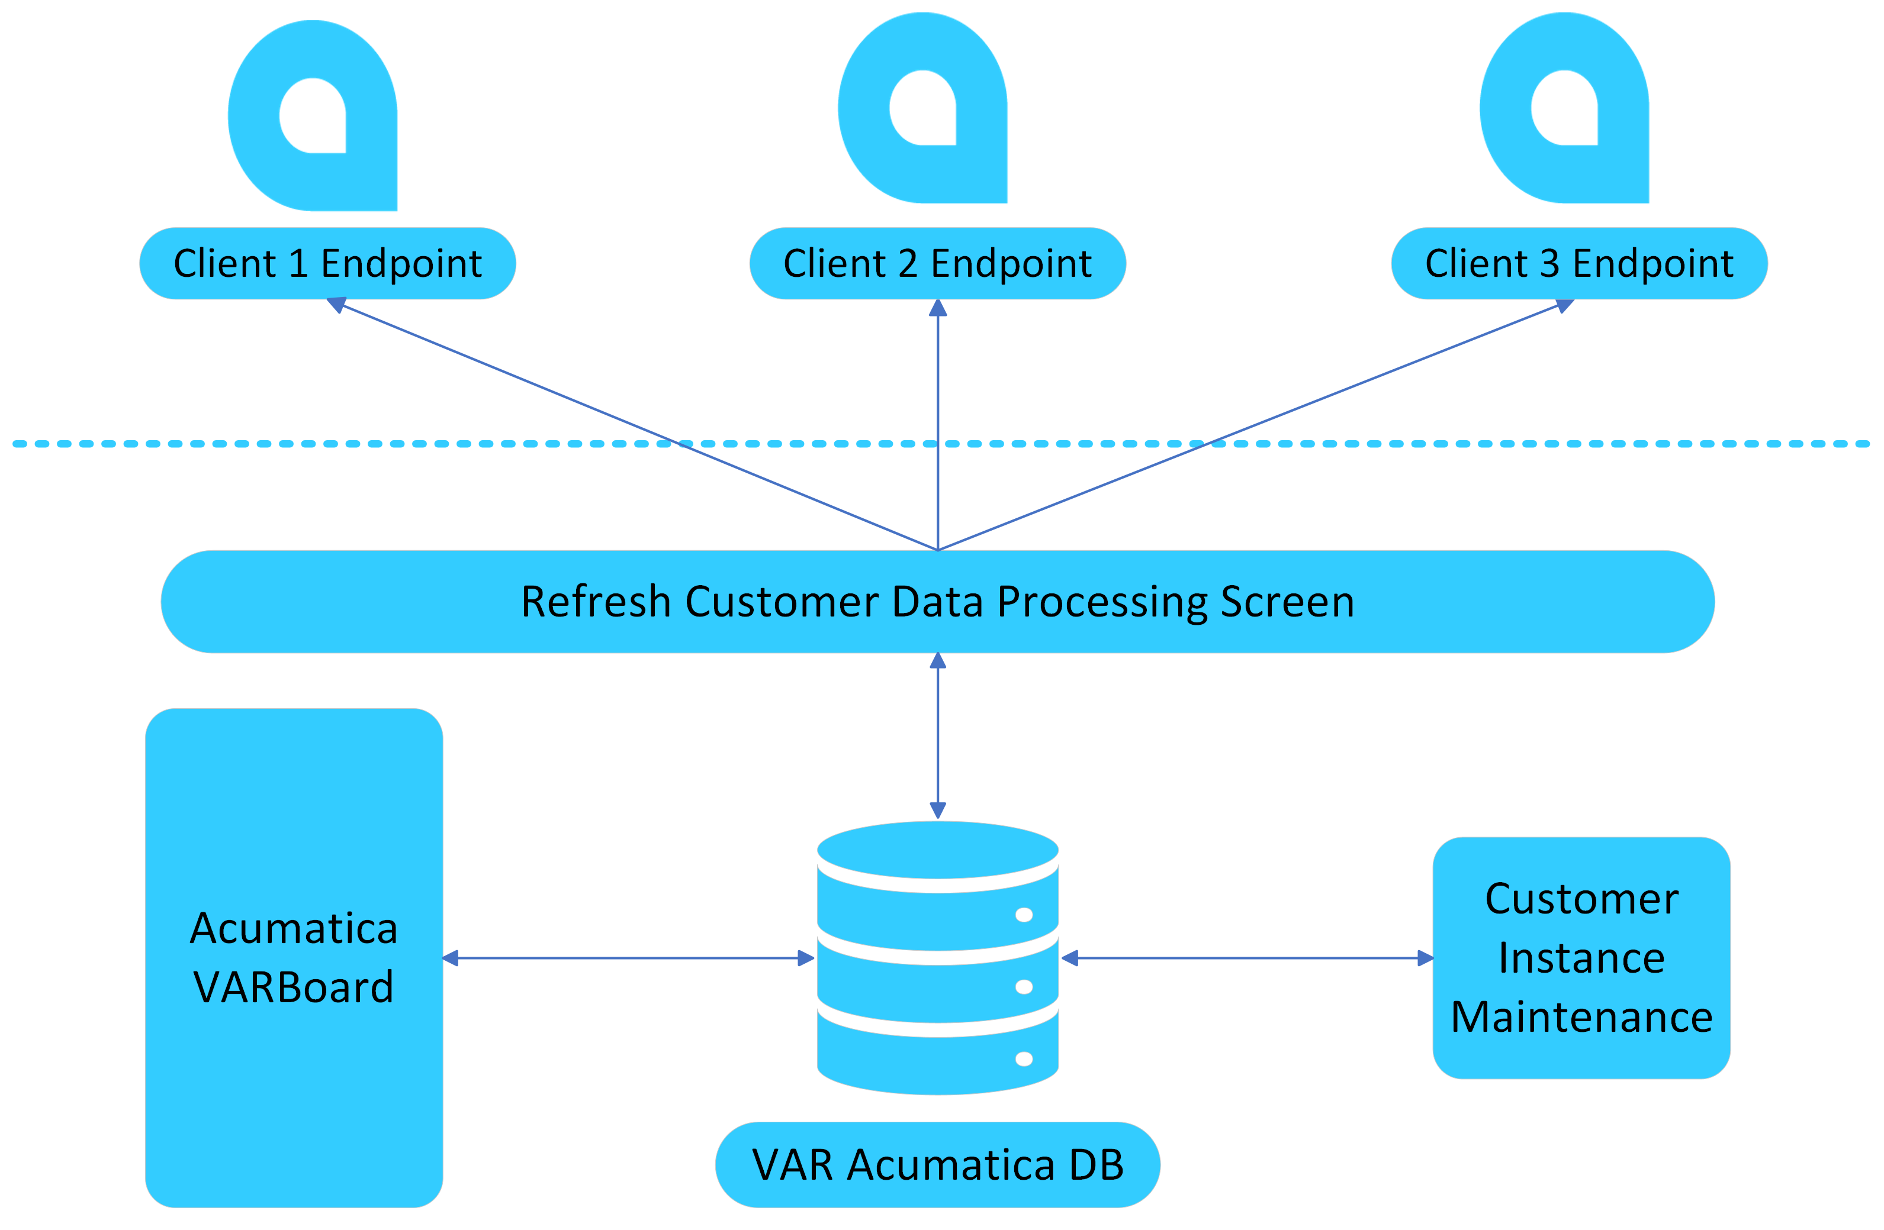
HMS VARBoard Design

Slide 6
Demo

Slide 7
HMS VARBoard Any Questions?

Slide 8
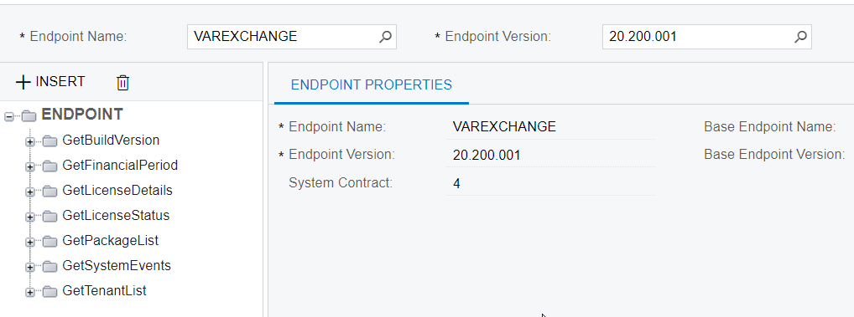
Endpoint Details

Slide 9
Details
Package Name:
VAR DATA EXCHANGE
On publishing of this package, we should have a custom end point created on the instance. This end point will be used to retrieve the data.
Package Endpoint:
VAREXCHANGE
Service Method Name | Service Method Ref Table
GetPackageList | Will Render All Packages List with Status ScreenID: SM203530
GetTenantList | Will Render All the Tenets in the Instance. ScreenID: SM203530
GetLicenseData | Will Render All the Licensing Info Specific to Instance. ScreenID: SM604000
FinancialPeriod | Custom Enquiry screen Will Return List of Financial Periods

Slide 10
Details
A configuration screen by which customer instance will be registered with the solution.
Screen Inputs:
Customer Name
URL
Endpoint Extension URL
Login Name
Password
Customer | URL | Endpoint Extension URL | Login Name | Login PSW | Action
ABC | https://abc.acumatica.com | xxxxxxxxxxxxxx | xxxxx | xxxxxxxxx | View | Refresh

Slide 11
Details
Packages Screen
Financial Period
Status | Name | Published Date | Published By
Active | XXXXXXX | XXXXXXX | XXXXXXX
Active | XXXXXXX | XXXXXXX | XXXXXXX
IN Active | XXXXXXX | XXXXXXX | XXXXXXX
Tenant | Current Finance Period | Closed Finance Period
Focus Global | XXXXXXX | XXXXXXX
Trident | XXXXXXX | XXXXXXX
Test | XXXXXXX | XXXXXXX

